Slide 1
Chapter VII: Applications of AI

Slide 2
Outline
Neural Network
Expert System
NLP
Machine Vision

Slide 3
Expert System
The expert systems are the computer applications developed to solve complex problems in a particular domain, at the level of extra-ordinary human intelligence and expertise.
An expert system is a set of program that manipulate encoded knowledge to solve problems in a specialized domain that normally requires human expertize
Expert systems are used by most of the large or medium sized organization as a major tool for improving productivity and quality
An expert system’s knowledge is obtained from expert source and code in a form suitable for the system to use in its reasoning process

Slide 4
Characteristics of Expert Systems
High performance
Understandable
Reliable
Highly responsive
Capabilities of Expert Systems
The expert systems are capable of −
Advising
Instructing and assisting human in decision making
Demonstrating
Deriving a solution
Diagnosing
Explaining
Interpreting input
Predicting results
Justifying the conclusion
Suggesting alternative options to a problem
They are incapable of −
Substituting human decision makers
Possessing human capabilities
Producing accurate output for inadequate knowledge base
Refining their own knowledge

Slide 5
Expert System
The sources for an expert system can be
  Specialists
  Texts
  Journal Articles
  Database

Slide 6
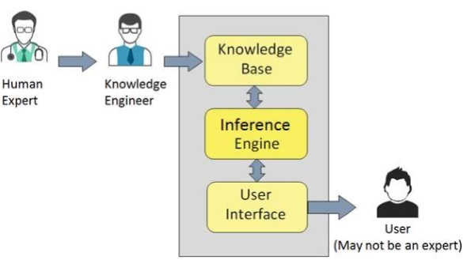

Slide 7
Expert System
Steps in a Expert System
Knowledge Acquisition
Knowledge Transfer
From experts or Other sources
To User
Knowledge
Representation
Knowledge Inferring
In Computer
In Computer

Slide 8
Expert System: Components
Knowledge Base: A declarative representation of expertise, often in IF Then rule
Working Storage: The data which is specific to a problem being solved
Inference Engine: The code at the core of the system which derives recommendations from the knowledge base and problem specific data in working storage
User Interface: The code that controls the dialog between the user and the system

Slide 9
Expert System: General Architecture
Working Storage
User Interface
Current Facts
and Knowledge
Window
Consultation Environment
User
Derived Recommendations
General Facts
and Rules
Development Environment
Inference Engine
Knowledge Base

Slide 10
Expert System
General Contents of Knowledge Base in an ES
  Theories about the problem area
  Rules and procedures regarding the general problem area
  Rules (heuristics) of what to do in a given problem situation
  Global strategies for solving these types of problems
  Meta Knowledge
  Fact about the problem area

Slide 11
Expert System: Features
Goal Driven (Backward Chaining) or Data Driven (Forward Chaining) Reasoning
Coping with uncertainty
Data Representation
User Interface
Explanations (ability to explain solution w.r.t. problem specification
Use knowledge rather than data
Use symbolic representation for knowledge
Should have meta knowledge

Slide 12
Expert System: Advantages
Provide consistent answers for repetitive decisions, processors and tasks
Hold and maintain significant levels of information
Encourage organization to clarify the logic of their decision making
Ask question like human expertise

Slide 13
Expert System: Disadvantages
Lack of common sense needed in same decision making
Cant make creative responses as human expert would in unusual circumstances
Not able to explain their logic and reasoning
Error may occur n the knowledge base and lead to wrong decision making
Cant adopt to changing environment, unless knowledge base is changed

Slide 14
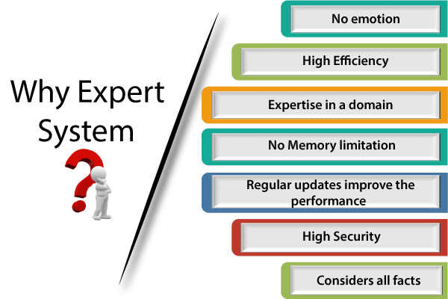

Slide 15
Expert System: Example → DENDRAL
First ES developed in late 1960s
Designed to analyse mass spectra
Based on the mass of fragments seen in the spectra, it would be possible to make inference as the nature of molecule tested, identifying functional groups or even the entire molecule
DENDRAL used heuristic knowledge obtained from experienced chemists
Uses forward chaining for reasoning
Discovered number of structures previously unknown to climate experts

Slide 16
Expert System: Example → MYCIN
An expert system for treating blood infections
MYCIN would attempt to diagnose patients based on reported symptoms and medical test results
Could ask some more information and lab test results for diagnosis
It would recommend a course of treatment, if requested MYCIN would explain the reasoning that lead to its diagnosis and recommendations
Uses about 500 production rules
MYCIN operated at roughly the same level of competence as human specialists in blood infections
Uses backward chaining for reasoning

Slide 17
Natural Language Processing
NLP is one of the field of AI that processes or analyses written or spoken language
Natural Language Processing (NLP) refers to AI method of communicating with an intelligent systems using a natural language such as English.
Processing of Natural Language is required when you want an intelligent system like robot to perform as per your instructions, when you want to hear decision from a dialogue based clinical expert system, etc.
The field of NLP involves making computers to perform useful tasks with the natural languages humans use.
The input and output of an NLP system can be −
Speech
Written Text

Slide 18
Components of NLP
There are two components of NLP as given −
Natural Language Understanding (NLU)
Understanding involves the following tasks −
Mapping the given input in natural language into useful representations.
Analyzing different aspects of the language.
Natural Language Generation (NLG)
It is the process of producing meaningful phrases and sentences in the form of natural language from some internal representation.
It involves −
Text planning − It includes retrieving the relevant content from knowledge base.
Sentence planning − It includes choosing required words, forming meaningful phrases, setting tone of the sentence.
Text Realization − It is mapping sentence plan into sentence structure.

Slide 19
NLP: Processes
Frames
Structure of Language
Auditory or Test Input
Segmentation
Syntax Analysis
Source
Pragmatics
Semantic Analysis
In which way context contributed to meaning
Meaning of Language

Slide 20
NLP: Fundamental Issues
Semantic Issue: Words used by one set of people could have different meaning for different set of people, example: “vegetable is hot”
Syntax Issue: The fundamental structure of the sentence itself can give rise to ambiguities, example: “I saw the boy in the park with telescope”
Semantic Issue: Extensive use of pronouns increase ambiguity level, example: “Ravi went to the market, he found his favourite brand of tea in third shelf. He paid (for it) and left.""He found his favorite brand of tea":
Does "his" refer to Ravi, or could it refer to someone else mentioned earlier in the broader context?
"He paid (for it)":
"He" could ambiguously refer to Ravi or another male person previously mentioned.
"It" could ambiguously refer to the tea or another item from the market.

Slide 21
NLP: Fundamental Issues
Syntax Issue: Conjunctions used in NL avoid repetition of phrases also causing NLP Problems, example: “Ram and Shyam went to a restaurant while Ram had a cup of coffee and Shyam had tea (a cup of)
Ellipsis is also a major issue in NLP, example: “I know SQL”

Slide 22
NLP: NL Analysis Techniques
Keyboard Analysis or Pattern Matching, Example: (acting humanly)

Slide 23
NLP: Keyboard Analysis
Start
Accept the given sentence
Scan and segment the sentence
Identify Keywords
If keywords present check the number of keywords
If yes prioritize them then give suitable reply
If no keywords are present give a random reply
stop

Slide 24
NLP: Syntactic Driven Parsing Technique
Words can fit together to form higher level units such as phrases, clauses and sentences
Interpretation of larger groups of words are built up out of the interpretation of their syntactic constituent words or phrases
Interpretation of input is done as whole
Obtained by application of grammar (determines what sentences are legal in the language is being parsed)
It involves processing of speech, grammar and meaning

Slide 25
NLP: Applications
To interface database
Classifying and retrieving documents by contents
Explanation generation for expert system
Machine translation
Advanced word processing tools

Slide 26
Machine /Computer Vision
Computer vision is concerned with modeling and replicating human vision using computer software and hardware.
Formally if we define computer vision then its definition would be that computer vision is a discipline that studies how to reconstruct, interrupt and understand a 3d scene from its 2d images in terms of the properties of the structure present in scene.
It needs knowledge from the following fields in order to understand and stimulate the operation of human vision system.
Computer Science
Electrical Engineering
Mathematics
Physiology
Biology
Cognitive Science

Slide 27
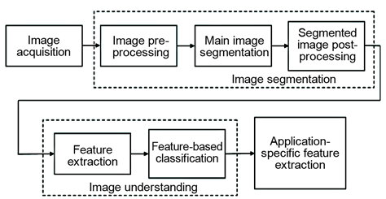

Slide 28
Related Fields
Computer Vision overlaps significantly with the following fields:
Image Processing: it focuses on image manipulation.
Pattern Recognition: it studies various techniques to classify patterns.
Photogrammetry: it is concerned with obtaining accurate measurements from images.
Example Applications
Robotics(Navigation, Obstacle Avoidance, Human Robot Interaction)
Medicine(Classification and Detection, MRI or Ultrasound etc. )
Security(Biometric, Surveillance detection, etc.)
Transportation(Autonomous Vehicle, Driver vigilance monitoring etc.)
Industrial Automation(Defect detection, Barcode and package label reading, Document understanding(e.g. OCR), Object sorting etc.)

Slide 29
Artificial Neural Network
Neural networks, also known as artificial neural networks (ANNs) or simulated neural networks (SNNs), are a subset of machine learning and are at the heart of deep learning algorithms.
Their name and structure are inspired by the human brain, mimicking the way that biological neurons signal to one another.
Artificial neural networks (ANNs) are comprised of a node layers, containing an input layer, one or more hidden layers, and an output layer.
Each node, or artificial neuron, connects to another and has an associated weight and threshold.
If the output of any individual node is above the specified threshold value, that node is activated, sending data to the next layer of the network. Otherwise, no data is passed along to the next layer of the network.

Slide 30
The brain consists of a densely interconnected set of nerve cells or basic information processing unit called neurons
The human brain incorporates nearly 10 billion neurons and 60 trillion connections called synapses between them
By using multiple neurons simultaneously, the brain can perform its function much faster than the fastest computers in the existence today

Slide 31
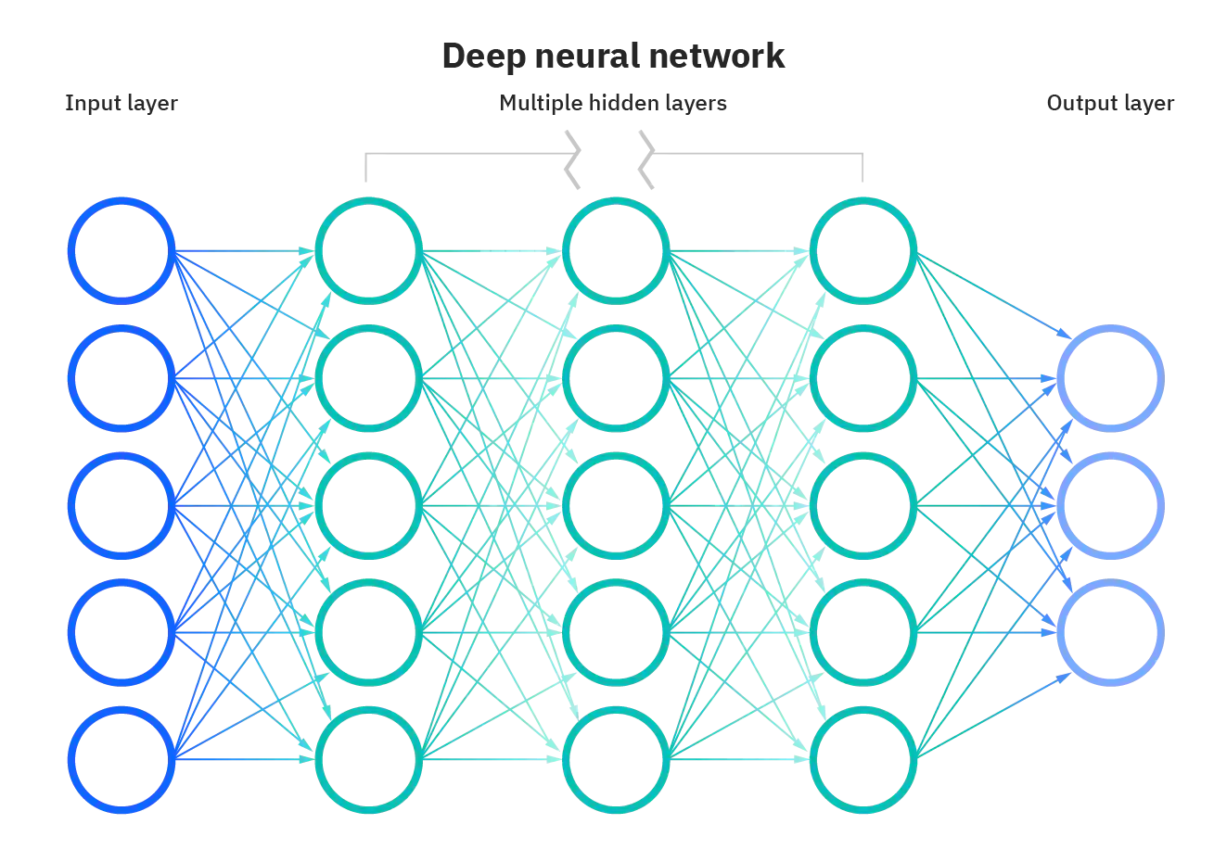

Slide 32
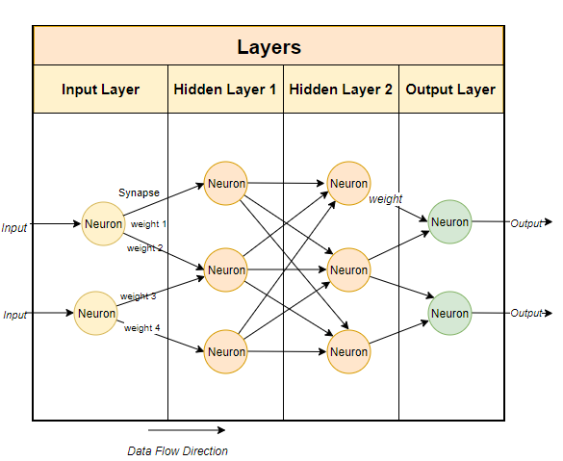

Slide 33
Each neuron has a very simple structure, but an army of such elements constitutes a tremendous processing power
A neuron consist of a cell body called soma, a number of fibres called dendrites, a single long fibre called axon and connective called synapse
An ANN work in similar fashion as the natural neuron works, i.e. it is trained with set of data from the environment under which it is suppose to work
NN is a mathematical model of information processing analogous to human brain

Slide 34
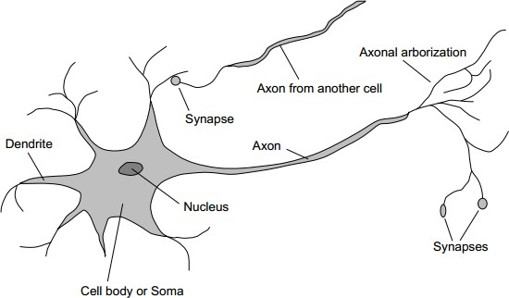
Neural Network: Brain
Neuron: fundamental function unit of all nervous system tissue
Soma: cell body, contain nucleus
Dendrites: a number of fibres, input
Axon: single long fibre with many branches, output
Synapse: junction of dendrites and axon, each neuron form synapse with 10 to 100000 other neurons

Slide 35
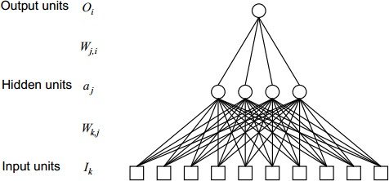
Artificial Neural Network: Typical Architecture

Slide 36
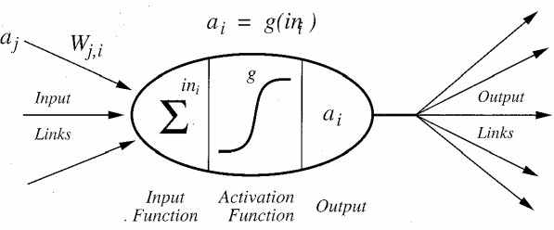
ANN: Neuron
The neuron computes the weighted sum of input signals and compares the result with a threshold value
If the net output is less than the threshold the neuron output is -1 else
+1
+1 𝑖𝑓 𝑋 > 𝜃
−1 𝑖𝑓 𝑋 ≤ 𝜃
i.e. 𝑋 = ∑^{𝑛}
𝑥 𝑤 , 𝑌 =
𝑖=1
𝑖 𝑖
Where, Θ is threshold value for which sign activation function is used

Slide 37
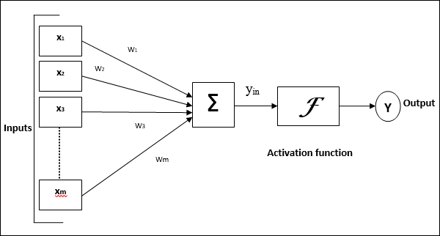
For the above general model of artificial neural network, the net input can be calculated as follows −
yin=x1.w1+x2.w2+x3.w3…xm.wm
i.e., Net input yin=∑mixi.wi
The output can be calculated by applying the activation function over the net input.
Y=F(yin)

Slide 38
Activation Functions
It may be defined as the extra force or effort applied over the input to obtain an exact output.
In ANN, we can also apply activation functions over the input to get the exact output.
Activation function decides, whether a neuron should be activated or not by calculating weighted sum and further adding bias with it.
The purpose of the activation function is to introduce non-linearity into the output of a neuron.
We know, neural network has neurons that work in correspondence of weight, bias and their respective activation function.
In a neural network, we would update the weights and biases of the neurons on the basis of the error at the output.
This process is known as back-propagation.
Activation functions make the back-propagation possible since the gradients are supplied along with the error to update the weights and biases.

Slide 39
VARIANTS OF ACTIVATION FUNCTION :-
1). Linear Function :-
Equation : Linear function has the equation similar to as of a straight line i.e. y = ax
No matter how many layers we have, if all are linear in nature, the final activation function of last layer is nothing but just a linear function of the input of first layer.
Range : -inf to +inf
Uses : Linear activation function is used at just one place i.e. output layer.
Issues : If we will differentiate linear function to bring non-linearity, result will no more depend on input “x” and function will become constant, it won’t introduce any ground-breaking behavior to our algorithm.
For example : Calculation of price of a house is a regression problem. House price may have any big/small value, so we can apply linear activation at output layer. Even in this case neural net must have any non-linear function at hidden layers.

Slide 40
2). Sigmoid Function :-
It is a function which is plotted as ‘S’ shaped graph.
Equation :
A = 1/(1 + e^{-x})
Nature : Non-linear. Notice that X values lies between -2 to 2, Y values are very steep. This means, small changes in x would also bring about large changes in the value of Y.
Value Range : 0 to 1
Uses : Usually used in output layer of a binary classification, where result is either 0 or 1, as value for sigmoid function lies between 0 and 1 only so, result can be predicted easily to be 1 if value is greater than 0.5 and 0 otherwise.

Slide 41
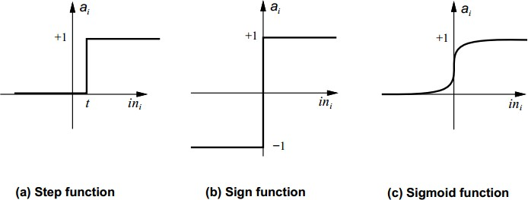
ANN: Different Activation Functions Used
Step function
₌ 1 𝑖𝑓 𝑥 ≥ 𝑡
𝑦 𝑥
0 𝑖𝑓 𝑋 < 𝑡
Sign function
1 𝑖𝑓 𝑥 ≥ 0
𝑦 𝑥 =
−1 𝑖𝑓 𝑥 < 0
Sigmoid function
1
𝑦 𝑥
=
1 + 𝑒^{−𝑥}
Linear function, 𝑦 𝑥 = 𝑥

Slide 42
ANN: Features
It can perform tasks that a linear program can not perform
When an element of the NN fails, it can continue without any problem by their parallel nature because of their distributive information nature
A NN learns and does not need to be reprogrammed
Has capabilities of massive parallel processing

Slide 43
ANN: Steps in NN Development
Define Problem
Data Selection, Preparation, Pre-processing
Select a Learning Algorithm
Train the Network with training Data
Test the Network with test Data
Run the Neural Network

Slide 44
ANN: Applications
Image Processing
Pattern Recognition
Expert Systems

Slide 45
ANN: Learning Techniques
Supervised Learning
Unsupervised Learning

Slide 46
ANN: Supervised Learning
Network is trained by providing with the inputs and outputs patterns
These I/O pairs can be provided externally or by the system which contains the NN
A supervised learning algorithm analyses the training data and produces an inferred function which is called a classifier if the output is discrete or a regressive function if the output is continuous
Wide range of supervised learning algorithms are available with its strengths and weaknesses but there is no single learning algorithm that works best on all supervised learning problems
Example: Back Propagation Technique

Slide 47
ANN: Unsupervised Learning
In contrast with supervised learning there are no explicit target outputs or environmental evaluations associated with each input
Unsupervised learning studies how systems can learn to represent particular input patterns in a way that reflects the statistical structure of overall collection of input patterns
Unsupervised learning can be thought of as finding patterns in the data above and beyond what would be considered as pure unstructured noise
Simplest example is clustering
In NN model other commonly used algorithms are self organizing map and adaptive resonance theory

Slide 48
ANN: Learning Rate
During ANN learning, to change the input/output behavior, we need to adjust the weights.
Hence, a method is required with the help of which the weights can be modified.
These methods are called Learning rules, which are simply algorithms or equations.
It is a constant in the algorithm of a NN that affects the speed of learning
It is a control parameter of some training algorithms, which controls the step size when weights are iteratively adjusted
The performance of the algorithm is very sensitive to the proper setting of the learning rate

Slide 49
ANN: Learning Rate
If the learning rate is set too high, the algorithm may oscillate and become unstable whereas if the learning rate is too small, the algorithm will take too long to converge
It is not practically significant to determine the optimal setting for the learning rate before training
In most of the cases the optimal learning rate changes during the training process

Slide 50
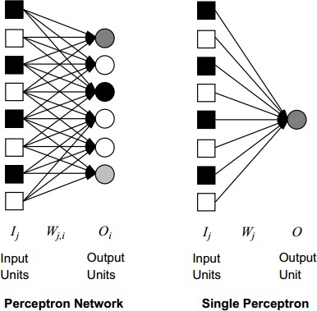
ANN: Perceptron
A perceptron is the simplest kind of feed forward neural network invented by Frank Rosenblatt
Its output is given by
𝑌 = 𝑆𝑡𝑒𝑝(∑ 𝑤_{𝑖}𝑥_{𝑖})
It can learn any linearly separable functions, given enough training

Slide 51
ANN: Learning Algorithm
Initialize weights and threshold
Present input and desired output
Calculate the output as,
𝑛
𝑂𝑢𝑡𝑝𝑢𝑡 = ∑ 𝑤_{𝑖}𝑥_{𝑖} − 𝜃
𝑖=1
4. Adapt weight as,
𝑤_{𝑖} t + 1 = 𝑤_{𝑖} 𝑡 + 𝛼 𝑑_{𝑖} − 𝑦_{𝑖} . 𝑥_{𝑖}(𝑡)
Where α is learning rate, d_{i} is desired output, y_{i} is observed output and x_{i} is input and d_{i}=e_{i}(t)

Slide 52
ANN: Hebbian Learning
The operation of a NN is determined by the values of the interconnection weights
There is no algorithm that determines how the weight should be assigned in order to solve a specific problem
Hence the weights are determined by a learning process
Hebbian learning is one of the same

Slide 53
ANN: Hebb’s Algorithm
Initialize all weights to 0
Given a training input, s, with its target output, t, set the activations of input units x_{i}=s_{i}
Set the activation of the output unit to the target value, y=t
Adjust the weights : wi(new)= w_{i}(old)+x_{i}y
Adjust the bias: b(new)=b(old)+y

Slide 54
ANN: Back Propagation Neural Network
Backpropagation is the essence of neural network training.
It is the method of fine-tuning the weights of a neural network based on the error rate obtained in the previous epoch (i.e., iteration).
Proper tuning of the weights allows you to reduce error rates and make the model reliable by increasing its generalization.
Backpropagation in neural network is a short form for “backward propagation of errors.”
It is a standard method of training artificial neural networks.
This method helps calculate the gradient of a loss function with respect to all the weights in the network.

Slide 55
ANN: Back Propagation Neural Network
It is a learning rule to multi layer network
In a back propagation NN, the learning algorithm has two phases
First a training input pattern is presented to the network input layer
The network propagates the input pattern from layer to layer until the output pattern is generated by the output layer
If this pattern is different from the desired output, an error is calculated
and propagated backward through the network from the output layer to input layer
The weights are modified as the error is propagated
Standard back propagation algorithm has a gradient descent algorithm to
adjust the network weights and moved along the negative of the gradient of the performance function

Slide 56
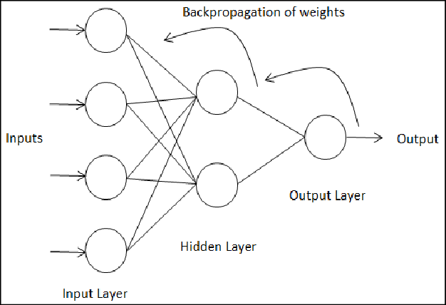

Slide 57
Other Neural Networks
Hopfield Neural Network
Kohonen Neural Network
Adaline Neural Network

Slide 58
Hopfield Networks
It consists of a single layer which contains one or more fully connected recurrent neurons.
The Hopfield network is commonly used for auto-association and optimization tasks.
Discrete Hopfield Network
A Hopfield network which operates in a discrete line fashion or in other words, it can be said the input and output patterns are discrete vector, which can be either binary 0,1 or bipolar +1,−1 in nature.
The network has symmetrical weights with no self-connections i.e., w_{ij} = w_{ji} and w_{ii} = 0.

Slide 59
Architecture
Following are some important points to keep in mind about discrete Hopfield network −
This model consists of neurons with one inverting and one non-inverting output.
The output of each neuron should be the input of other neurons but not the input of self.
Weight/connection strength is represented by w_{ij}.
Connections can be excitatory as well as inhibitory. It would be excitatory, if the output of the neuron is same as the input, otherwise inhibitory.
Weights should be symmetrical, i.e. w_{ij} = w_{ji}

Slide 60
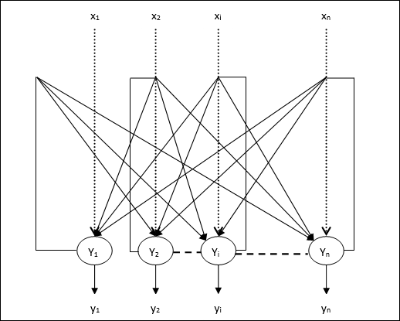

Slide 61
Kohonen's neural networks(Self Organizing Map)
Kohonen's networks are one of basic types of self-organizing neural networks.
The ability to self-organize provides new possibilities - adaptation to formerly unknown input data.
It seems to be the most natural way of learning, which is used in our brains, where no patterns are defined.
Those patterns take shape during the learning process, which is combined with normal work.
Kohonen's networks are a synonym of whole group of nets which make use of self-organizing, competitive type learning method.
We set up signals on net's inputs and then choose winning neuron, the one which corresponds with input vector in the best way.
Precise scheme of rivalry and later modifications of synaptic wages may have various forms. There are many sub-types based on rivalry, which differ themselves by precise self-organizing algorithm.

Slide 62
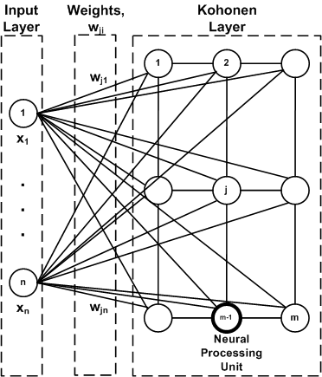

Slide 63
Adaline neural networks
Adaline which stands for Adaptive Linear Neuron, is a network having a single linear unit. It was developed by Widrow and Hoff in 1960.
Some important points about Adaline are as follows −
It uses bipolar activation function.
It uses delta rule for training to minimize the Mean-Squared Error (MSE) between the actual output and the desired/target output.
The weights and the bias are adjustable.
Architecture
The basic structure of Adaline is similar to perceptron having an extra feedback loop with the help of which the actual output is compared with the desired/target output.
After comparison on the basis of training algorithm, the weights and bias will be updated.

Slide 64
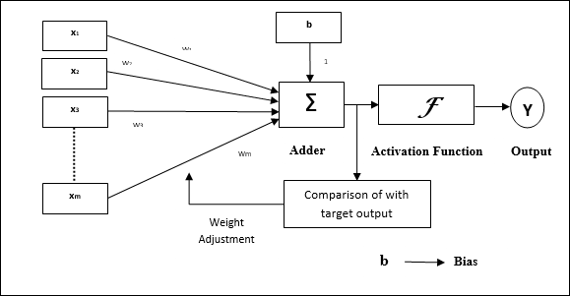

Slide 65
Training Algorithm
Step 1 − Initialize the following to start the training −
Weights
Bias
Learning rate α
For easy calculation and simplicity, weights and bias must be set equal to 0 and the learning rate must be set equal to 1.
Step 2 − Continue step 3-8 when the stopping condition is not true.
Step 3 − Continue step 4-6 for every bipolar training pair s:t.
Step 4 − Activate each input unit as follows −
xi=si(i=1ton)
Step 5 − Obtain the net input with the following relation −
yin=b+∑inxiwi

Slide 66
Here ‘b’ is bias and ‘n’ is the total number of input neurons.
Step 6 − Apply the following activation function to obtain the final output −
f(yin)={1−1ifyin⩾0ifyin<0
Step 7 − Adjust the weight and bias as follows −
Case 1 − if y ≠ t then,
wi(new)=wi(old)+α(t−yin)xi
b(new)=b(old)+α(t−yin)

Slide 67
Case 2 − if y = t then,
wi(new)=wi(old)
b(new)=b(old)
Here ‘y’ is the actual output and ‘t’ is the desired/target output.
(t−yin)
is the computed error.
Step 8 − Test for the stopping condition, which will happen when there is no change in weight or the highest weight change occurred during training is smaller than the specified tolerance.

